Slide 1

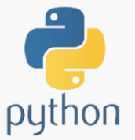

Apache PySPARK
+
=
6
Video-

Slide 2
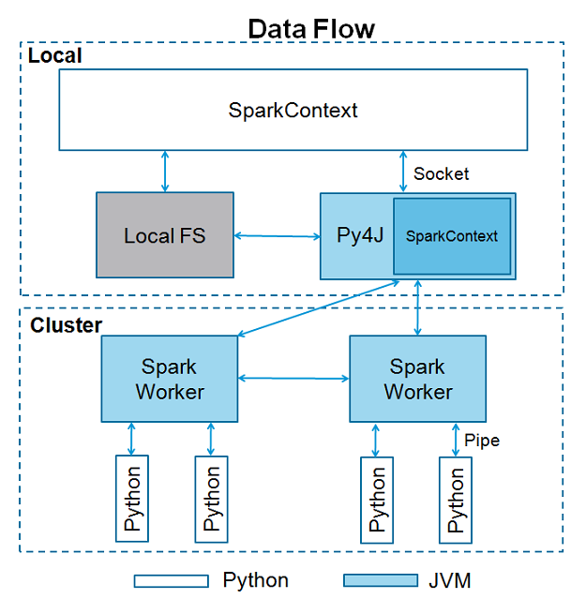
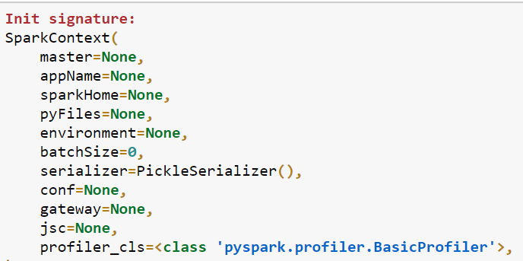
Spark Context
The entry point to any spark functionality. When we run any Spark application, a driver program starts,which has the main function and your SparkContext gets initiated here.
Spark automatically creates the SparkContext object named sc, when PySpark shell starts.
In case you try to create another SparkContext object, you will get the following error – "ValueError: Cannot run multiple SparkContexts at once".

Slide 3
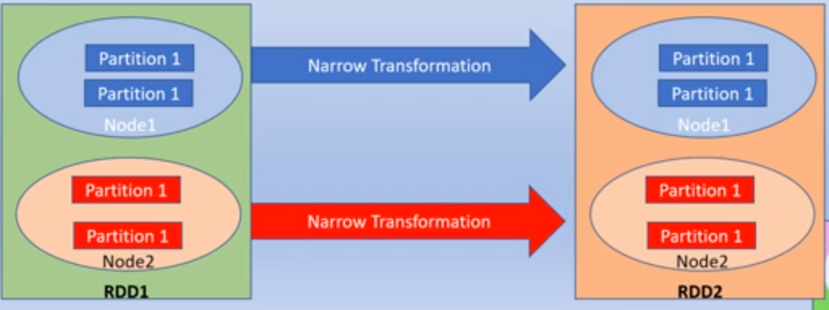
Narrow Transformation ( pipelining )
All the elements that are required to do calculation lies in the single partition of parent RDD
A limited Subset of partition is used to calculate the result
No shuffling of data across the nodes in the cluster
Example
  MAP, FLATMAP, MAP Partitions
  Filter
  Sample
  Union

Slide 4
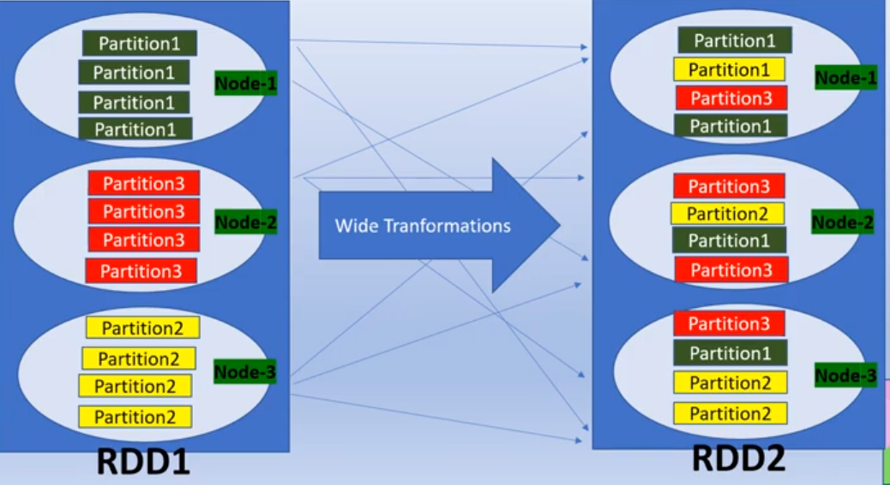
Wide Transformation ( Shuffling )
All the elements that are required to do calculation, may live in many partition of parent RDD
Partition live in many partition of parent RDD This result in shuffling of data across the nodes in the Spark cluster.
Computational Expensive.
Example
  Intersection and Join
  Distinct
  Cartesian
  Repartition
  Coalesce
  GroupByKey()
  ReduceByKey()

Slide 6
